Slide 1
Inside a Datacenter Hardware and Software Architecture
Wei Bai
Microsoft Research Redmond
Guest Lecture, Cloud Computing @ Boston University
Notes:
Self introduction

Slide 2
Disclaimer
The opinions in this talk are my own.
Datacenter architecture is a very large topic. In this talk, I will focus on networking and briefly discuss storage and compute.
I will use many Microsoft products and technologies as examples in this talk. But general concepts should be able to be applied to other companies as well.
Material with thanks to Mark Russinovich, Albert Greenberg, Dave Maltz, Marcus Fontoura, Daniel Firestone, Costin Raiciu and others.
Notes:
Before I talk about datacenters, I want to mention a few points here.

Slide 3
What is a datacenter?
Notes:
Let’s start with a fundamental question: what is a datacenter?

Slide 4
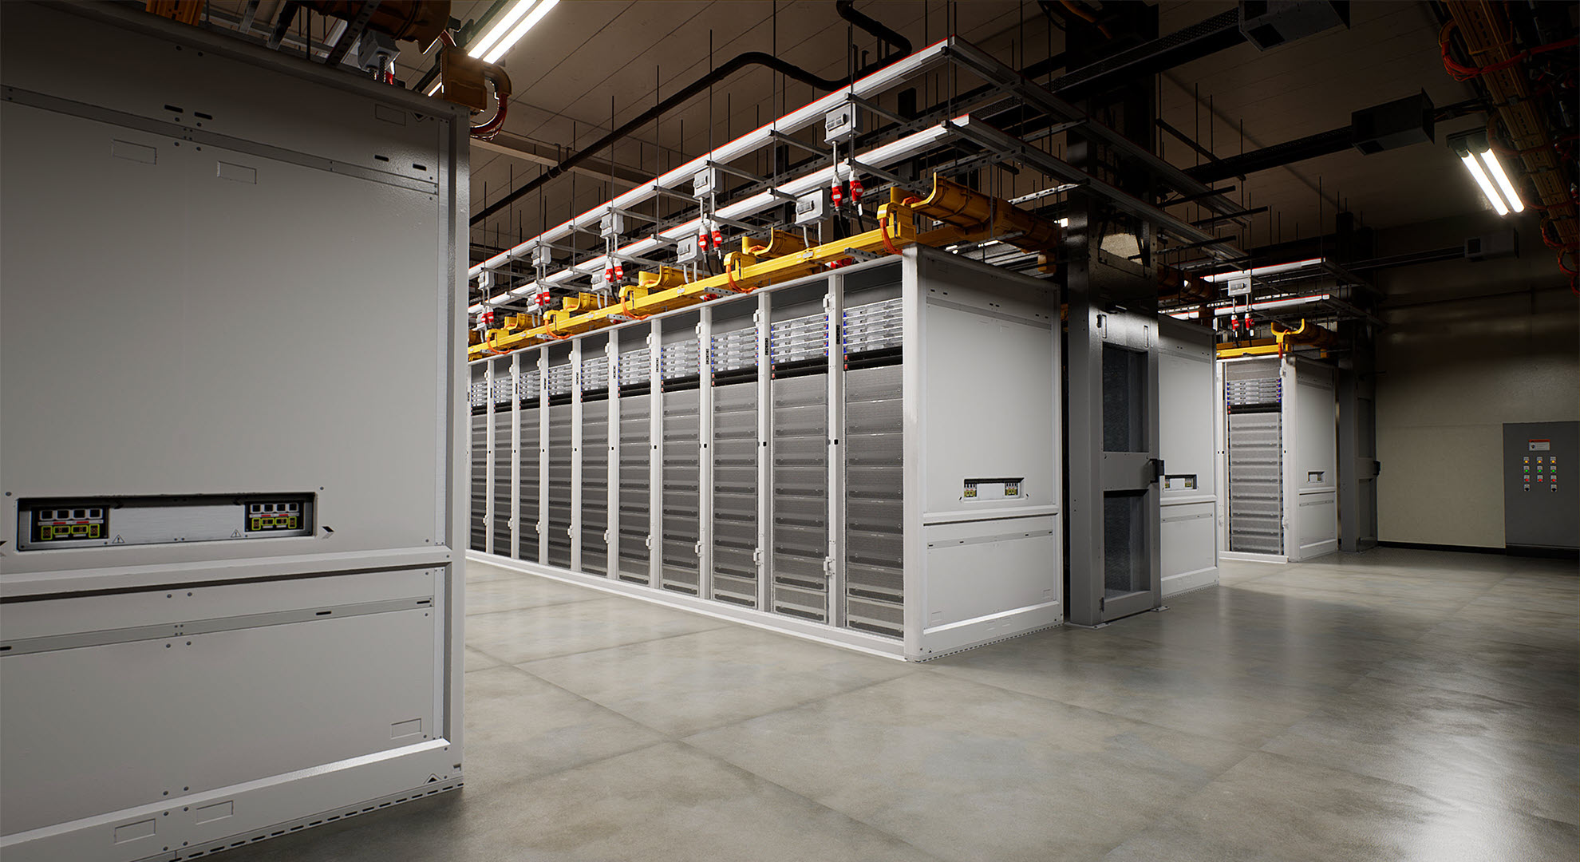
A datacenter is a building, or a dedicated space used to house computer systems and associated components, such as telecommunications and storage systems.
Notes:
According to Wikipedia, a datacenter is a facility used to house computer systems and associated components, such as power, cooling, telecommunications and storage systems. To some degree, you can think data center as a server room. But data center is super large.

Slide 5
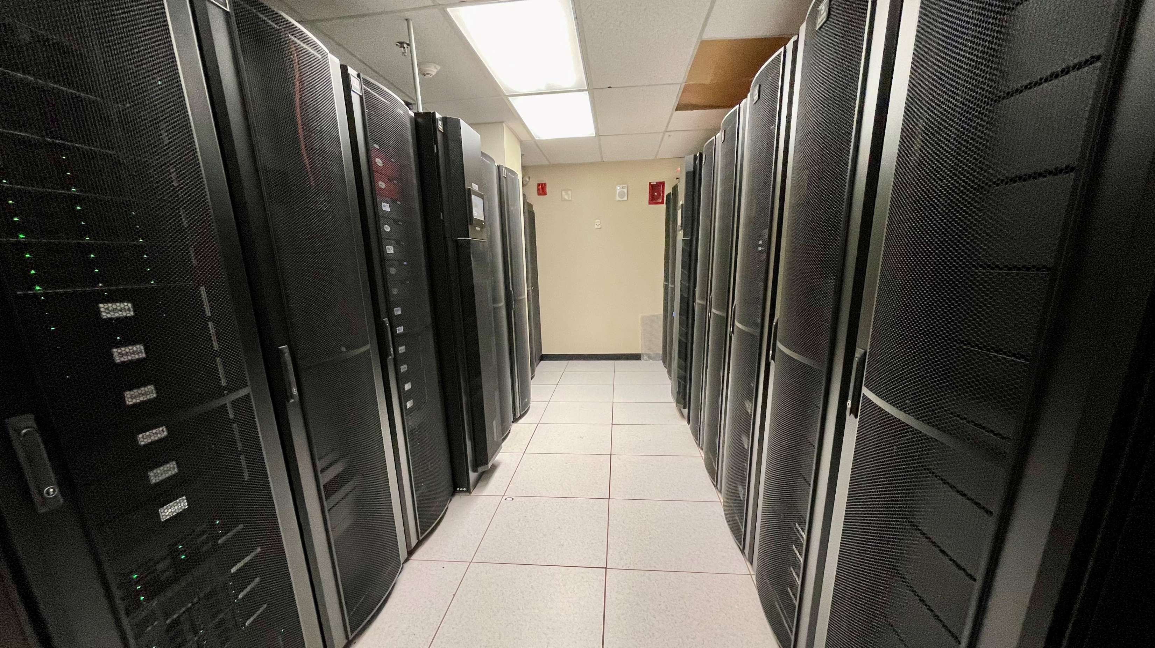

Slide 6
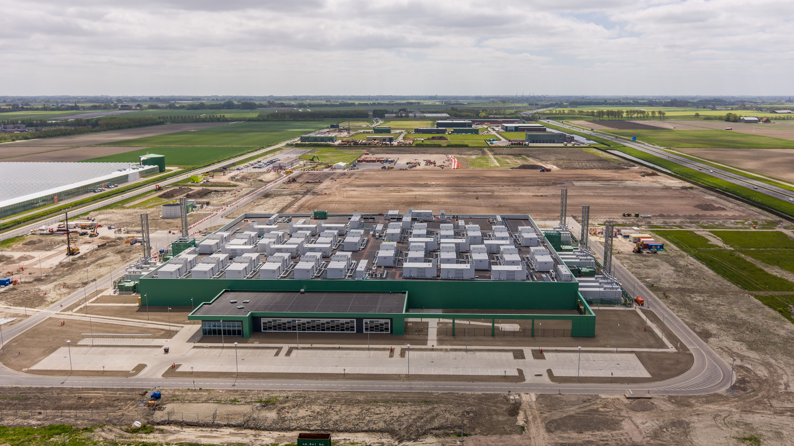
Microsoft @ Amsterdam

Slide 7
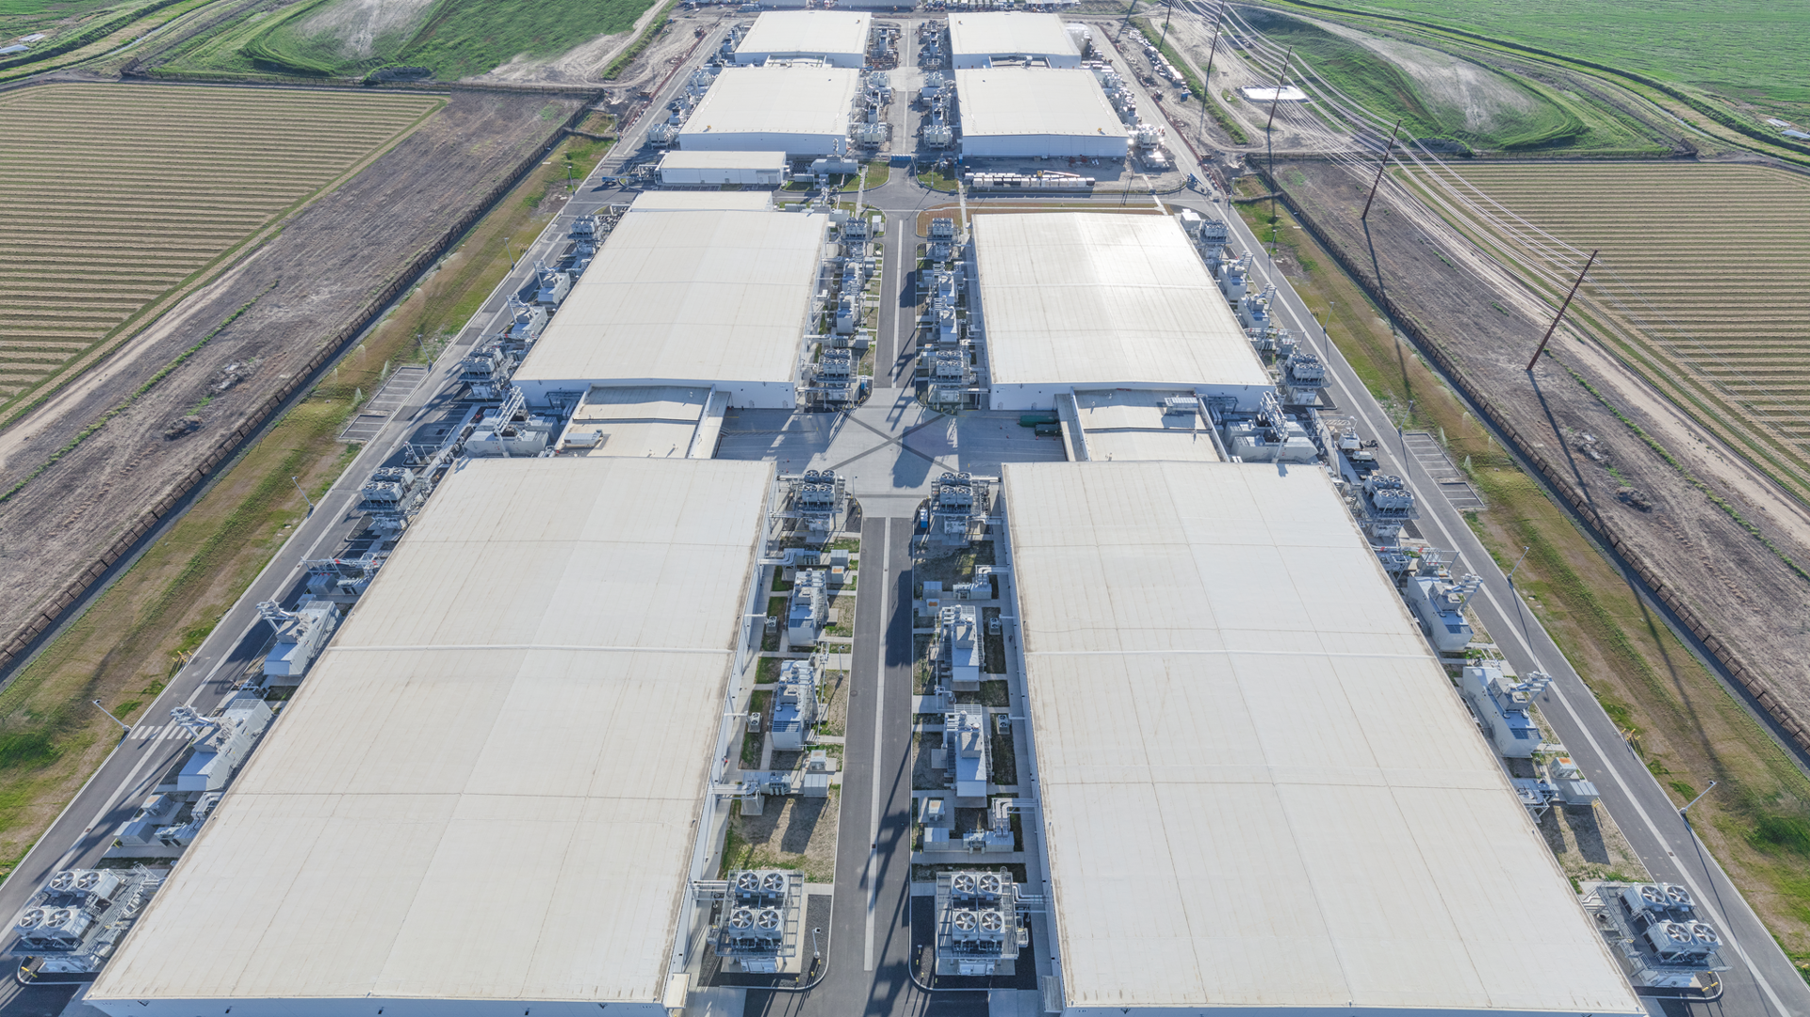
Microsoft @ Quincy

Slide 8
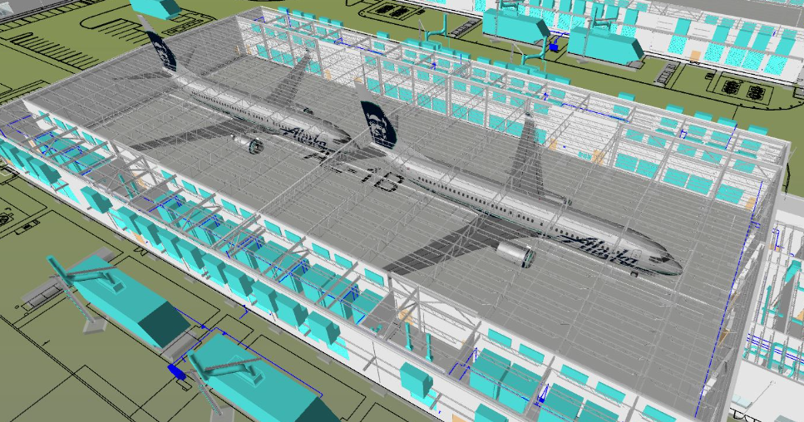
Notes:
I use this figure to give you some sense of the physical size of a data center. This is an architecture rendering of one of our data center buildings. Note that we don’t really put any 747 in our data centers. But these two 747s give you some sense of how large the physical space is. A production data center can host 10s of thousands of machines.

Slide 9
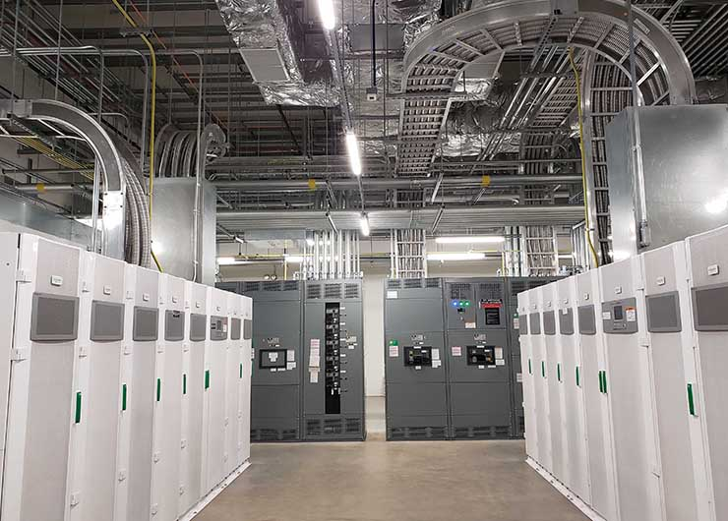
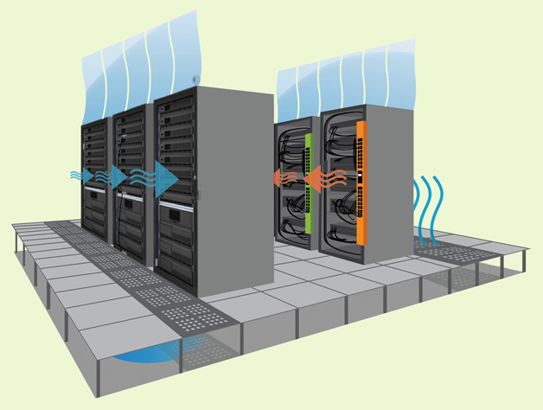
Power and Cooling
Notes:
If you operate a datacenter, there are two things you must keep in mind. Power is the critical element that brings a data center to life and keeps your IT infrastructure up and running even during a disruption. I cannot stress enough the importance of power in the data center. Data centers use a lot of power, which translates into heat. So we need to ensure that all equipments are running within desired temperature ranges.

Slide 10
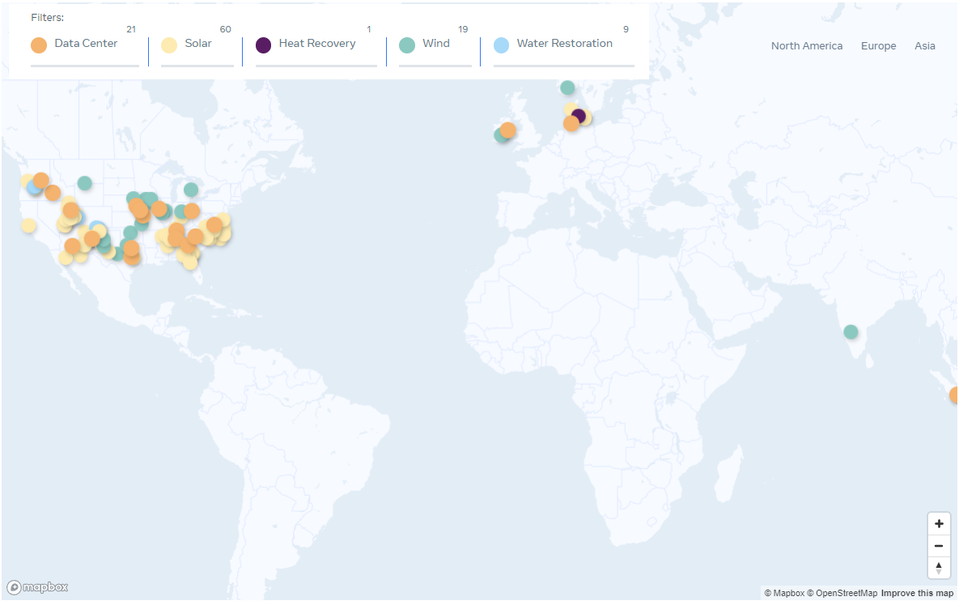
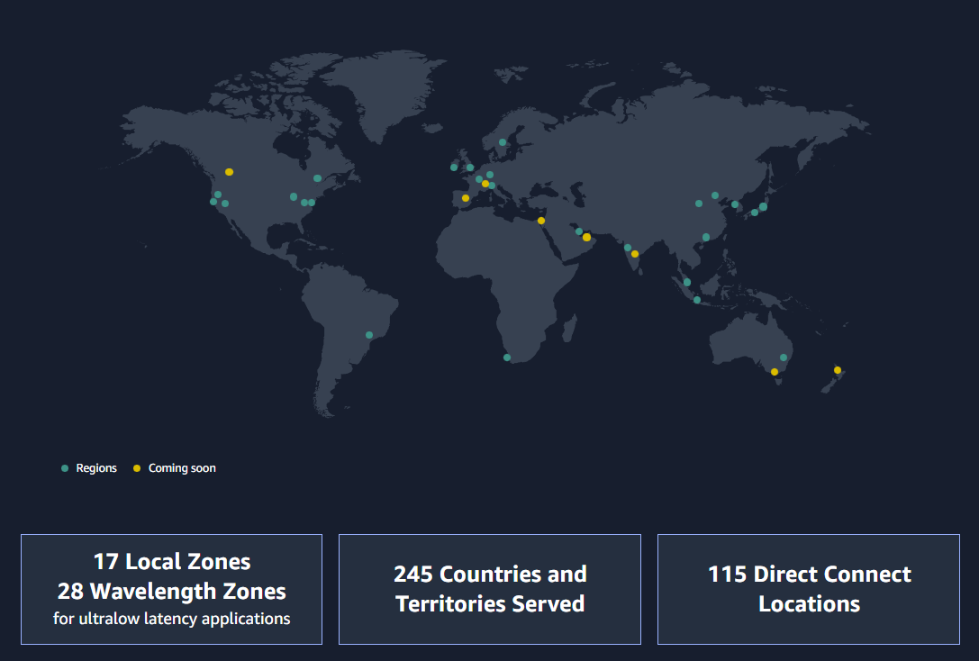
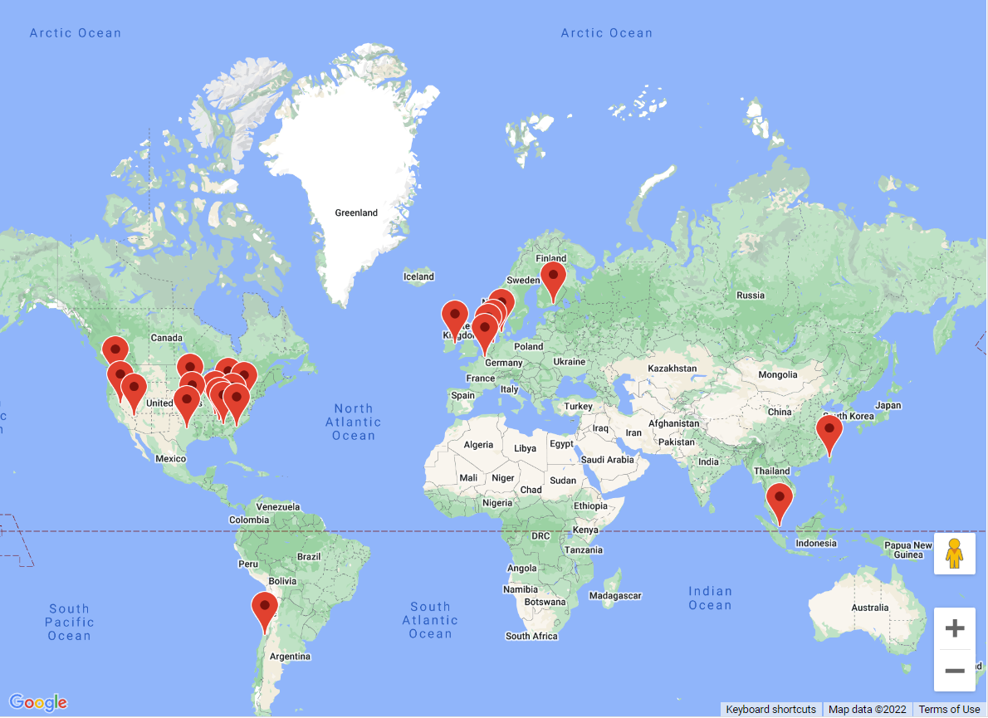
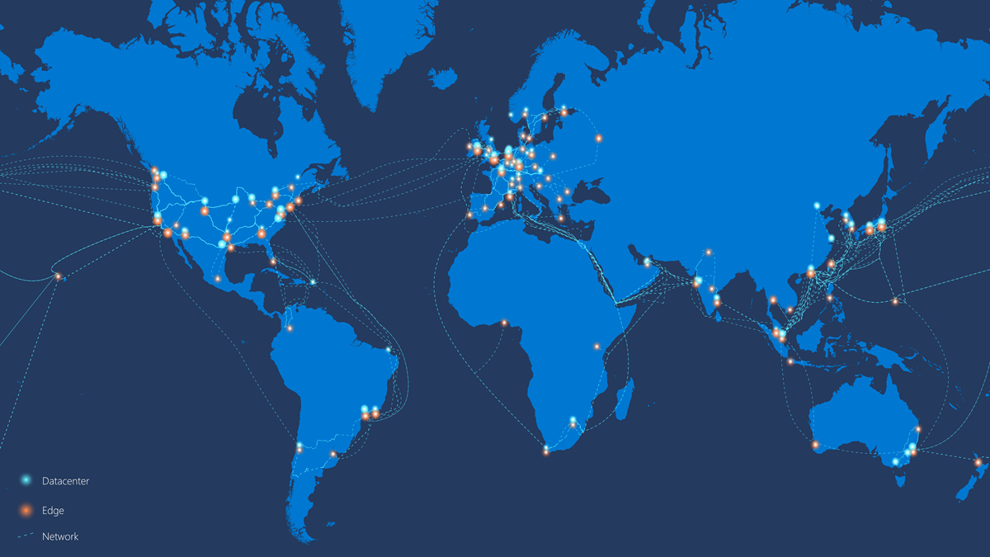
https://aws.amazon.com/about-aws/global-infrastructure/
https://datacenters.fb.com/
https://www.google.com/about/datacenters/locations/
https://docs.microsoft.com/en-us/azure/networking/microsoft-global-network
Notes:
Given the trend of cloud computing and digital transformation, many companies are building a lot of data centers around the world to provide service to global users. Here I show four companies, meta, amazon, google and Microsoft. All these four companies have a significant amount of first-party workloads, for example, Facebook social networking, Amazon shopping, Google search, Bing search and Microsoft office 365. But except for meta, all the other three companies provide cloud computing services. This means that Amazon, Google and Microsoft’s data centers run a mix of first-party and third-party workloads.

Slide 11
Physical Networking
How to connect servers within a datacenters?
How to connect different datacenters and Internet?
Notes:
After talking about the basic knowledge of datacenters, let’s move to physical networking. In datacenter context, the physical networking needs to address two key problems.

Slide 12
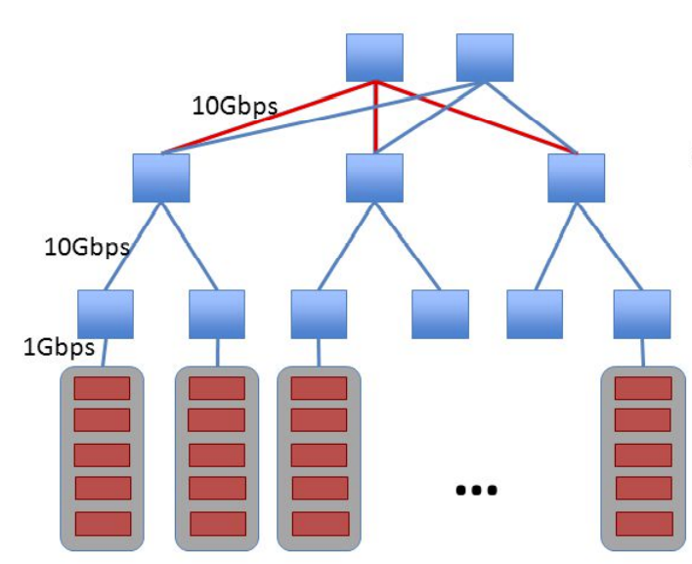
Traditional Data Center Topology (2008)
Core Switches
Aggregation Switches
Top of Rack Switches
Racks of Servers
Notes:
Data center network topology and architecture has become a very hot topic since 2008. At that time, I was still a high school student. This slide gives a figure of traditional DCN topology in 2008. Tens of servers are connected to a top of rack switch using 1Gbps links. Every top of rack switch is connected to an aggregation switch using a 10Gbps link. An aggregation switch can be connected to multiple core switches.

Slide 13
Problems in Traditional Solutions
Lack robustness
Aggregation switch failures wipe out several racks
Poor performance
Oversubscription = max_host_throughput / worst_case_throughput
Typical oversubscription ratio 4:1, 8:1, 10:1
Expensive
7K for 48-port Gigabit switch
700K for 128-port 10Gigabit switch
Notes:
So what are the problems of the traditional solution?

Slide 14
Ideal Datacenter Network Topology
Offer full-bisection bandwidth
Over-subscription ratio of 1:1
Worst case: every host can talk to every host at line rate!
Is fault tolerant
Is cheap
Notes:
So how does an ideal datacenter network topology look like?

Slide 15
The Fat Tree [Al-Fares et al, SIGCOMM 2008]
Inspired from the telephone networks of the 50’s – Clos networks
Use cheap, commodity switches – all switches are the same
Lots of redundancy
Single parameter to describe the topology:
K – the number of ports in a switch
Notes:
To realize the ideal datacenter network topology, some researchers from UCSD design a network called fat tree.

Slide 16
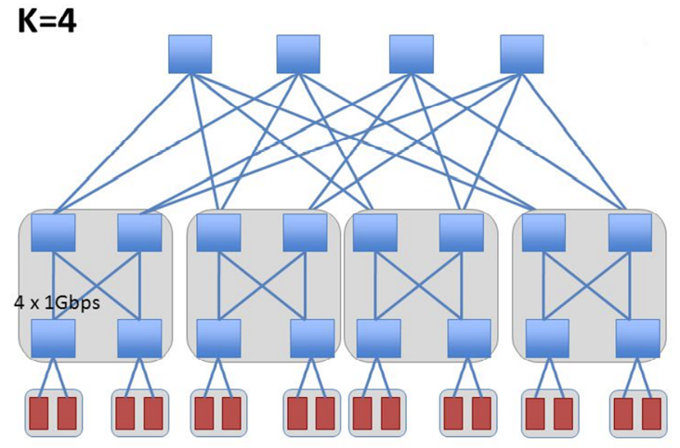
Fat Tree Topology
Core Switches
Aggregation Switches
Edge Switches
Servers
𝐾^3/4
Notes:
This figure shows a fat tree with K = 4. This means that every switch has 4 ports. There are three tiers of switches.

Slide 17
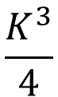
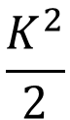
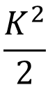
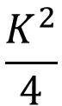
Fat Tree Topology
$$\frac{K^{2}}{4}$$
Core Switches
$$\frac{K^{2}}{2}$$
Aggregation Switches
$$\frac{K^{2}}{2}$$
Edge Switches
$$\frac{K^{3}}{4}$$
Servers
𝐾^3/4
Notes:
Fat tree has some basic properities.

Slide 18
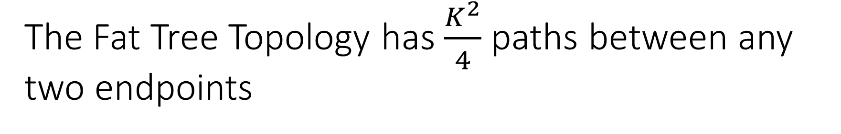
The Fat Tree Topology has $\frac{K^{2}}{4}$ paths between any two endpoints
$$\frac{K^{2}}{4}$$
Core Switches
$$\frac{K^{2}}{2}$$
Aggregation Switches
$$\frac{K^{2}}{2}$$
Edge Switches
$$\frac{K^{3}}{4}$$
Servers
𝐾^3/4
Notes:
This figure shows a fat tree with K = 4.

Slide 19
Routing: how to use these paths
Layer 2: Spanning Tree Protocol (STP)
STP does not offer multiple paths
What about L2 broadcasts? (e.g., ARP)
Layer 3: Equal Cost Multipath Routing (ECMP)
When there are multiple shortest paths, pick one “randomly”
Hash packet header to choose a path
All packets of the same flow go on the same path
Why not use per-packet ECMP?
Notes:
So how to use these paths.
First option ..
Second option is ..

Slide 20
How about datacenter networks
for cloud services?
Notes:
After talking about general datacenter networks, let us take one step further. How should we design our datacenter networks for cloud services?

Slide 21
Tenets of Cloud-Service Data Center
Agility: Assign any servers to any services
Boosts cloud utilization
Scaling out: Use large pools of commodities
Achieves reliability, performance, low cost
Statistical Multiplexing Gain
Economies of Scale
Notes:
A cloud data center is shared by multiple tenants. There are two key requirements.

Slide 22
What is VL2?
The first DC network that enables agility in a scaled-out fashion
Why is agility important?
Today’s DC network inhibits the deployment of other technical advances toward agility
With VL2, cloud DCs can enjoy agility in full

Slide 23
Status Quo: Conventional DC Network
Internet
CR
CR
DC-Layer 3
. . .
AR
AR
AR
AR
DC-Layer 2
S
S
Key
CR = Core Router (L3)
AR = Access Router (L3)
S = Ethernet Switch (L2)
A = Rack of app. servers
S
S
S
S
. . .
A
A
…
A
A
A
…
A
~ 1,000 servers/pod == IP subnet
Reference – “Data Center: Load balancing Data Center Services”, Cisco 2004
Notes:
Conventional DC network is built using both layer 3 forwarding routers and layer 2 forwarding switches.

Slide 24
Conventional DC Network Problems
CR
CR
~ 200:1
AR
AR
AR
AR
S
S
S
S
~ 40:1
S
S
S
S
. . .
S
S
S
S
~ 5:1
A
A
…
A
A
A
…
A
A
A
…
A
A
A
…
A
Dependence on high-cost proprietary routers
Extremely limited server-to-server capacity

Slide 25
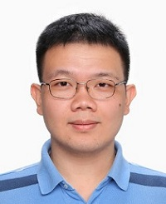

And More Problems …
CR
CR
~ 200:1
AR
AR
AR
AR
Complicated manual L2/L3 re-configuration
S
S
S
S
S
S
S
S
S
S
S
S
A
…
A
A
…
A
A
A
…
A
A
A
…
A
A
A
A
IP subnet (VLAN) #1
IP subnet (VLAN) #2
Resource fragmentation, significantly lowering cloud utilization (and cost-efficiency)
Notes:
Now let’s talk about more problems due to multi-tenancy in the cloud

Slide 26
And More Problems …
CR
CR
AR
AR
AR
AR
S
S
S
S
S
S
S
S
S
S
S
S
A
A
…
A
A
A
…
A
A
A
…
A
A
A
…
A
Revenue lost
Expense wasted
Resource fragmentation, significantly lowering cloud utilization (and cost-efficiency)

Slide 27
Know Your Cloud DC: Challenges
Instrumented a large cluster used for data mining and identified distinctive traffic patterns
Traffic patterns are highly volatile
A large number of distinctive patterns even in a day
Traffic patterns are unpredictable
Correlation between patterns very weak
Optimization should be done frequently and rapidly

Slide 28
Know Your Cloud DC: Opportunities
DC controller knows everything about hosts
Host OS’s are easily customizable
Probabilistic flow distribution would work well enough, because …
Flows are numerous and not huge – no elephants!
Commodity switch-to-switch links are substantially thicker (~ 10x) than the maximum thickness of a flow
DC network can be made simple

Slide 29
All We Need is Just a Huge L2 Switch, or an Abstraction of One
The Illusion of a Huge L2 Switch
1. L2 semantics
2. Uniform high capacity
3. Performance isolation
A
A
A
…
A
A
…
A
A
A
A
A
A
A
A
A
A
A
A
A
A
A
A
A
…
A
A
…
A
A
A
A
A
A
A
A
A
A
A
A
A
Notes:
From the tenant’s perspective, they don’t care about the data center network fabric. All they want is to get some VMs in the cloud, and connect these VMs to a layer 2 switch [click]. In this way, all the VMs are in the same subnet and can communicate with each other.
[click]. This l2 switch should have high bandwidth capacity.
[click] And different tenant’s L2 switches should get predictable performance.

Slide 30
Specific Objectives and Solutions
Objective
Approach
Solution
1. Layer-2 semantics
Employ flat addressing
Name-location separation & resolution service
2. Uniform high capacity between servers
Guarantee bandwidth for hose-model traffic
Flow-based random traffic indirection (Valiant LB)
3. Performance Isolation
Enforce hose model using existing mechanisms only
TCP
Notes:
VL2 tries to realize all the three objectives.

Slide 31
Addressing and Routing: Name-Location Separation
Cope with host churns with very little overhead
VL2
Switches run link-state routing and maintain only switch-level topology
Directory Service
…
x → ToR₂
y → ToR₃
z → ToR₄
…
…
x → ToR₂
y → ToR₃
z → ToR₃
…
ToR₁
. . .
ToR₂
. . .
ToR₃
. . .
ToR₄
ToR₃
y
payload
Lookup &
Response
y, z
ToR₄
x
y
z
ToR₃
z
z
payload
payload
Servers use flat names

Slide 32
Addressing and Routing: Name-Location Separation
Cope with host churns with very little overhead
VL2
Switches run link-state routing and maintain only switch-level topology
Directory Service
Allows to use low-cost switches
Protects network and hosts from host-state churn
Obviates host and switch reconfiguration
…
x → ToR₂
y → ToR₃
z → ToR₄
…
…
x → ToR₂
y → ToR₃
z → ToR₃
…
ToR₁
. . .
ToR₂
. . .
ToR₃
. . .
ToR₄
ToR₃
y
payload
Lookup &
Response
y, z
ToR₄
x
y
z
ToR₃
z
z
payload
payload
Servers use flat names

Slide 33
Example Topology: Clos Network
Offer huge aggr capacity and multi paths at modest cost
VL2
Int
. . .
10Gbps
Aggr
. . .
K aggr switches with D ports
10Gbps
. . .
. . . . . .
TOR
1Gbps
. . .
. . . . . . . .
20 Servers
20*(DK/4) Servers

Slide 34
Example Topology: Clos Network
Offer huge aggr capacity and multi paths at modest cost
VL2
Int
. . .
D (# of 10G ports) | Max DC size (# of Servers)
48 | 11,520
96 | 46,080
144 | 103,680
10Gbps
Aggr
. . .
K aggr switches with D ports
10Gbps
. . .
. . . . . .
TOR
1Gbps
. . .
. . . . . . . .
20 Servers
20*(DK/4) Servers

Slide 35
Traffic Forwarding: Random Indirection
Cope with arbitrary TMs with very little overhead
I_{ANY}
I_{ANY}
I_{ANY}
Links used for up paths
Links used for down paths
T₁
T₂
T₃
T₄
T₅
T₆
I_{ANY}
T₃
T₅
y
z
payload
payload
x
y
z

Slide 36
Traffic Forwarding: Random Indirection
Cope with arbitrary TMs with very little overhead
I_{ANY}
I_{ANY}
I_{ANY}
Links used for up paths
Links used for down paths
[ ECMP + IP Anycast ]
Harness huge bisection bandwidth
Obviate esoteric traffic engineering or optimization
Ensure robustness to failures
Work with switch mechanisms available today
T₁
T₂
T₃
T₄
T₅
T₆
I_{ANY}
T₃
T₅
y
z
payload
payload
x
y
z

Slide 37
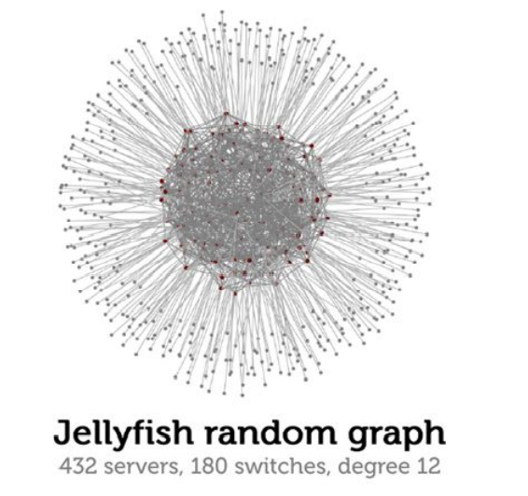
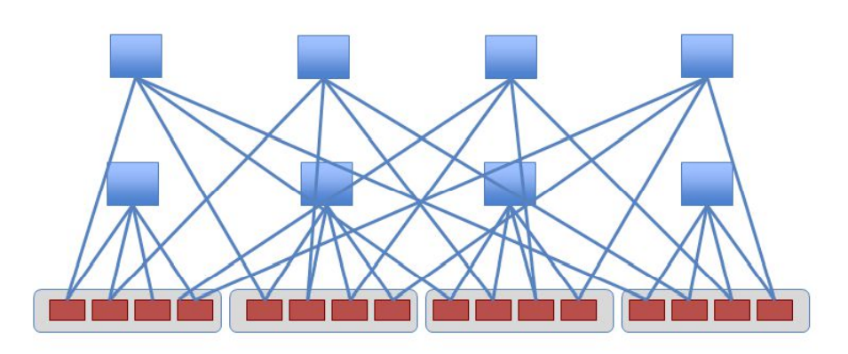
Other Topologies
Jellyfish [Singla et al, NSDI 2012]
BCube [Guo et al, SIGCOMM 2009]
Servers
Switches

Slide 38
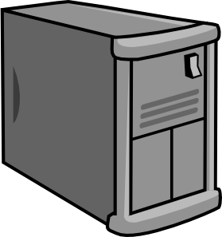
Reconfigurable Topologies
2 circuits
Optical Circuit Switching
Notes:
So far we have talked several topologies, fat tree, vl2. All these topologies are static.

Slide 39
Reconfigurable Topologies
Time Slot = 1

Slide 40
Reconfigurable Topologies
Time Slot = 2

Slide 41
Reconfigurable Topologies
Time Slot = 3

Slide 42
What topologies are used in practice?

Slide 43
VL2 -> Azure Clos Fabrics
Regional Hub
Data Center
Tier 2
Cluster
Tier 1
Tier 0
Server
Notes:
This figure gives the topology of an Azure region. Green ones are servers. Then there are four tiers of switches, T0, T1, T2 and RH.

Slide 44
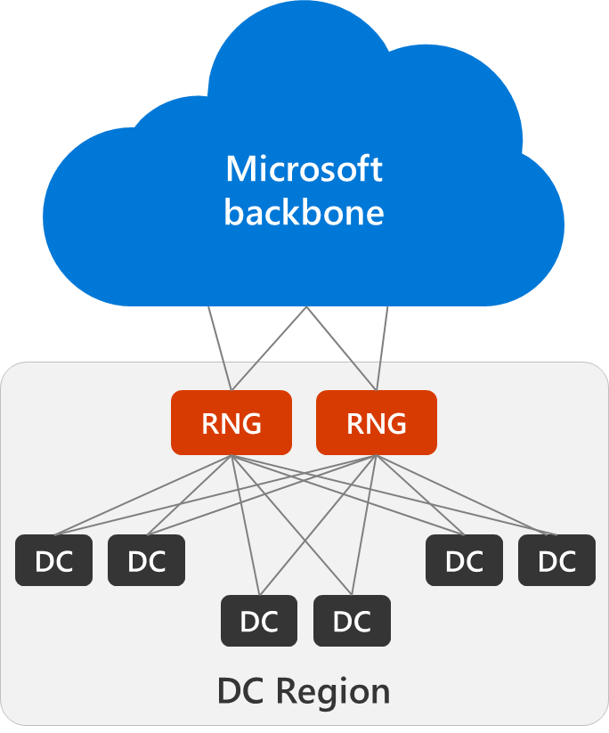
Regional Spine Architecture
Customers want the Cloud to be infinitely scalable – how to create that illusion?
Introducing: Regions
Contiguous geographical area up to roughly 100km in diameter (2.0ms RTT)
Regional network gateway
Massively parallel, hyper scale
Space and power protected
Data centers
Only contains server racks, DC network
RNGs are sized to support growing the region by adding data centers

Slide 45
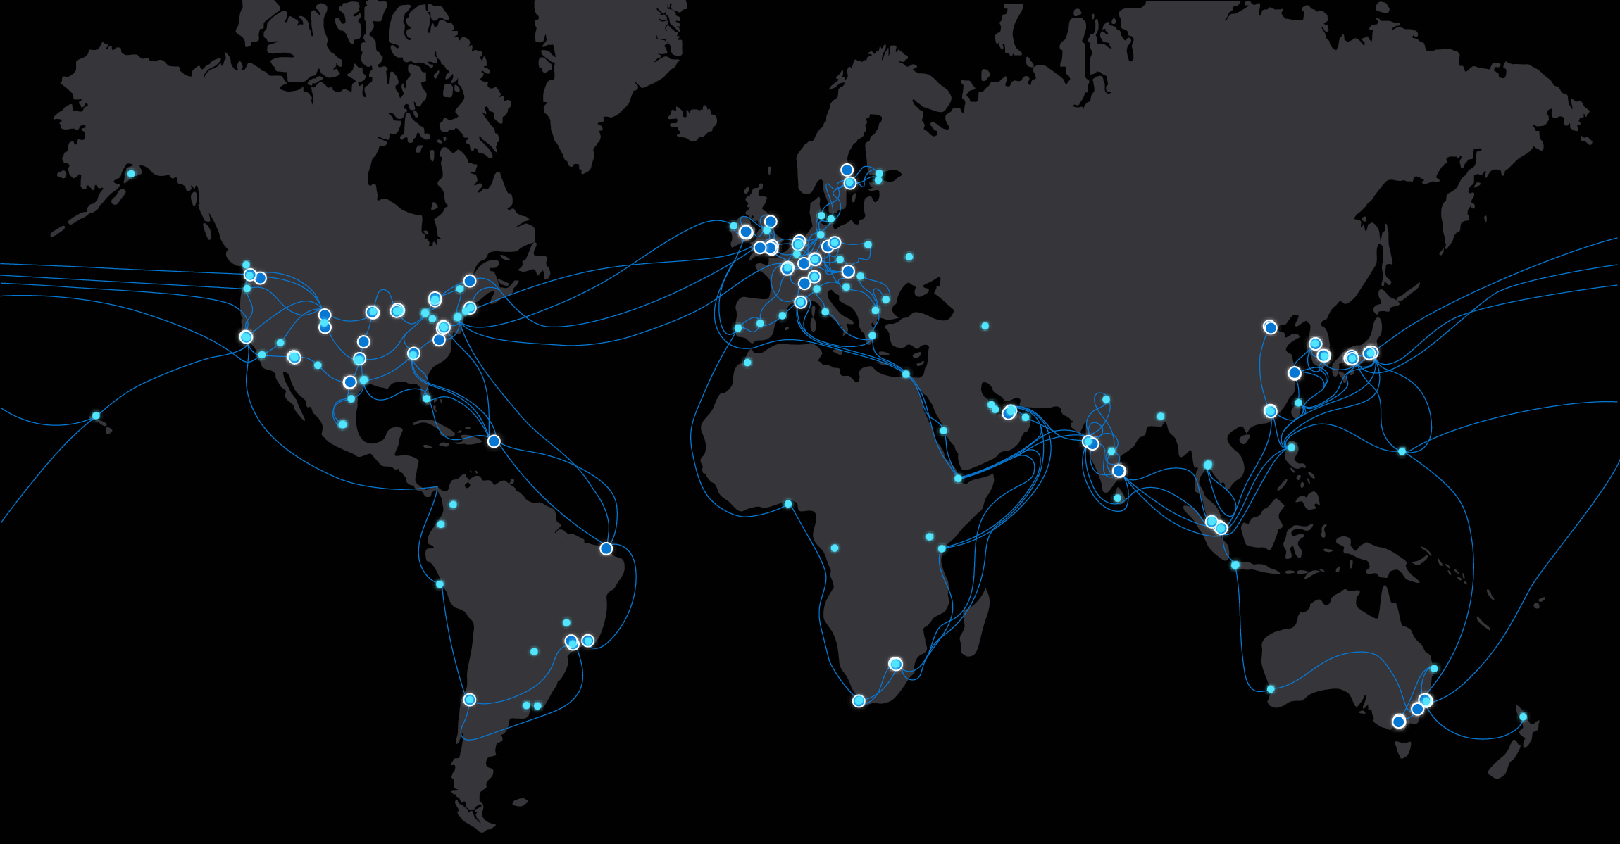
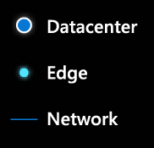
Microsoft Global Network
61
Azure regions
175k+
miles of fiber + subsea cables
185+
Network edge sites
200+
Express route partners
20k+
peering connections
Notes:
Microsoft owns and operates one of the largest global networks on the planet. This global and sophisticated architecture, spanning more than 175,000 miles of fiber, connects our datacenters and customers. Connecting our Microsoft data centers across 61 regions and large mesh of edge-nodes placed around the world, our global network offers both the availability, capacity, and the flexibility to meet any demand. These edge-nodes, all interconnected to more than 4,600 unique Internet partners (peers) through 20,000+ connections in more than 185 locations, provide the foundation of our interconnection strategy. Our edge PoP expansion mission is to reach every human on the planet within 25 milliseconds. Our policy is to establish peering directly in market with the local providers and carrying the traffic across our secure global backbone network to exit close to the user so that we control the quality over as much of the path as possible.

Slide 46




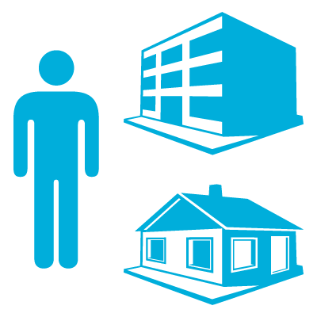
Microsoft Azure Networking
Azure Region ‘A’
Regional Network
Cable
CDN
Consumers
Regional Network
Microsoft Wide Area Network
Carrier
Edge
Enterprise, SMB, mobile
Azure Region ‘B’
Regional Network
ExpressRoute
Internet
Exchanges
Enterprise DC/Corpnet
Regional Network

Slide 47
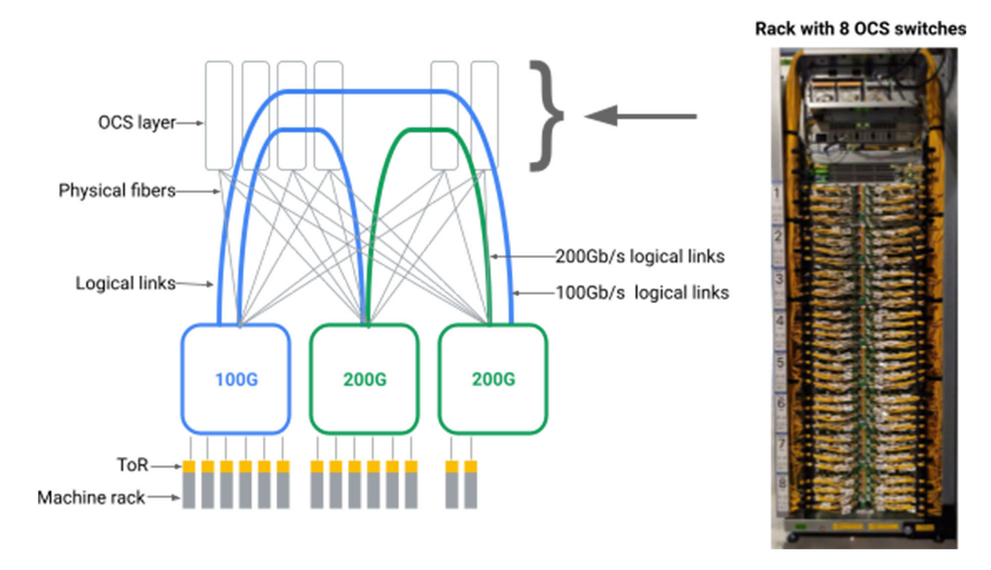
Google uses optical circuit switching (OCS) switches to reconfigure networks between aggregation blocks

Slide 48
Virtual Networking
How to enable multi-tenancy on a shared network fabric?

Slide 49
Customers only see Virtual Networks (VNets)
Internet
Internet
Public IP addresses
Public IP addresses
10.0.0.1
10.0.0.2
10.0.0.3
10.0.0.1
10.0.0.2
10.0.0.3
Private Network
Private Network
10.0.0.0/24
10.0.0.0/24

Slide 50
Key Mechanism: Packet Encapsulation
Secure, intra-tenant networks
on shared infrastructure
Virtual Network Controller
L3 Forwarding Policy
Policy lookup:
VM 10.1.1.3 is
on host with Physical Address
1.1.1.6
Src:1.1.1.5
Dst:1.1.1.6
GRE:Green
Src:10.1.1.2
Dst:10.1.1.3
Packet is on
Green Vnet:
Decap
Server1: 1.1.1.5
Server2: 1.1.1.6
Src:10.1.1.2
Dst:10.1.1.3
Azure VMSwitch
Azure VMSwitch
Src:10.1.1.2
Dst:10.1.1.3
Green VM1
10.1.1.2
Yellow VM1
10.1.1.2
Red VM1
10.1.1.2
Green VM2
10.1.1.3
Notes:
Take a look at concrete policy
1st green vm wants to talk to 2nd green vm
Green in own addr space different than that the physical network runs on
When packet goes out, policy lookup in the 1st VM switch. Looks up the destination address. Encapsulates the packet, and delivers it to the 2nd switch
Decaps and delivers to the green VM
Just used this model to program secure intra-tenant networks on shared infrastructure

Slide 51
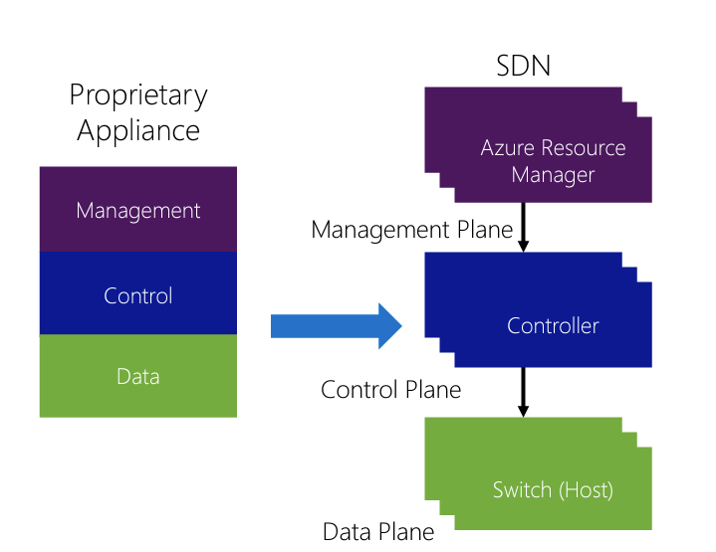
Azure Software Defined Networking (SDN)
Management plane | Create a tenant
Control plane | Plumb tenant policies to VM switches
Data plane | VM switches apply policies to flows
Key to flexibility and scale is Host SDN

Slide 52

Azure VM Switch: Virtual Filtering Platform
VNet Description
Virtual Filtering Platform (VFP) exposes a typed Match-Action-Table API to the agents/controllers
Key insight: Let controller tell switch exactly what to do with which packets
Tenant Description
Controller
VNet Routing Policy
NAT Endpoints
ACLs
Host: 10.4.1.5
VM Switch
Rule | Action
TO: 10.2/16 | Encap to GW
TO: 10.1.1.5 | Encap to 10.5.1.7
TO: !10/8 | NAT out of VNET
Rule | Action
TO: 79.3.1.2 | DNAT to 10.1.1.2
TO: !10/8 | SNAT to 79.3.1.2
Rule | Action
TO: 10.1.1/24 | Allow
10.4/16 | Block
TO: !10/8 | Allow
NIC
VM 1
10.1.1.2
VNET
LB NAT
ACL
Virtual Network
Load Balance
Network Address Translation
Access Control List

Slide 53
Generic Flow Table (GFT) – A Fastpath
First-packet actions can be complex
Established-flow matches must be typed, predictable, and simple hash lookups
First Packet
Rule Lookups (Expensive)
Flow | Action
Flow | Action
NIC
Rule | Action
TO: 10.2/16 | Encap to GW
TO: 10.1.1.5 | Encap to 10.5.1.7
TO: !10/8 | NAT out of VNET
Rule | Action
TO: 79.3.1.2 | DNAT to 10.1.1.2
TO: !10/8 | SNAT to 79.3.1.2
Rule | Action
TO: 10.1.1/24 | Allow
10.4/16 | Block
TO: !10/8 | Allow
VNET
LB NAT
ACL
VM 1
10.1.1.2
Flow | Action
10.1.1.2:80 to 10.2.3.5:9876 | DNAT + Encap to GW
10.1.1.2:80 to 10.2.1.5:9876 | Encap to 10.5.1.7
10.1.1.2:6754 64.3.2.5:80 | SNAT to 79.3.1.2
Subsequent Packets
VM Switch
Hash Lookups (Cheap)

Slide 54
Compute and Storage

Slide 55
Virtual Machines in Azure
Type | Sizes | Description
General Purpose | B, Dsv3, Dv3, Dasv4, Dav4, DSv2, Dv2, Av2, DC, DCv2, Dpdsv5, Dpldsv5, Dpsv5, Dplsv5, Dv4, Dsv4, Ddv4, Ddsv4, Dv5, Dsv5, Ddv5, Ddsv5, Dasv5, Dadsv5 | Balanced CPU-to-memory ratio. Ideal for testing and development, small to medium databases, and low to medium traffic web servers.
Compute optimized | F, Fs, Fsv2, FX | High CPU-to-memory ratio. Good for medium traffic web servers, network appliances, batch processes, and application servers.
Memory optimized | Esv3, Ev3, Easv4, Eav4, Epdsv5, Epsv5, Ev4, Esv4, Edv4, Edsv4, Ev5, Esv5, Edv5, Edsv5, Easv5, Eadsv5, Mv2, M, DSv2, Dv2 | High memory-to-CPU ratio. Great for relational database servers, medium to large caches, and in-memory analytics.
Storage optimized | Lsv2, Lsv3, Lasv3 | High disk throughput and IO ideal for Big Data, SQL, NoSQL databases, data warehousing and large transactional databases.
GPU | NC, NCv2, NCv3, NCasT4_v3, ND, NDv2, NV, NVv3, NVv4, NDasrA100_v4, NDm_A100_v4 | Specialized virtual machines targeted for heavy graphic rendering and video editing, as well as model training and inferencing (ND) with deep learning. Available with single or multiple GPUs.
High performance compute | HB, HBv2, HBv3, HC, H | Our fastest and most powerful CPU virtual machines with optional high-throughput network interfaces (RDMA).

Slide 56
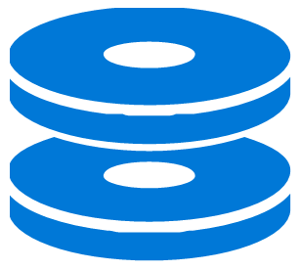
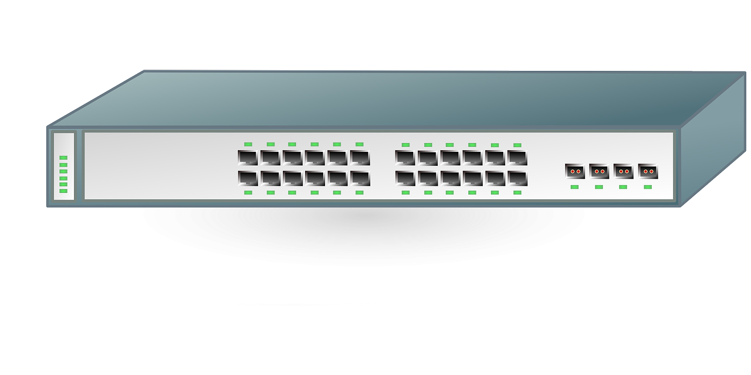
Compute-Storage Disaggregation
Compute Server
Storage Server
CPU
CPU
CPU
MEM
MEM
MEM
NIC
NIC
Datacenter Network
What are benefits of resource disaggregation?

Slide 57
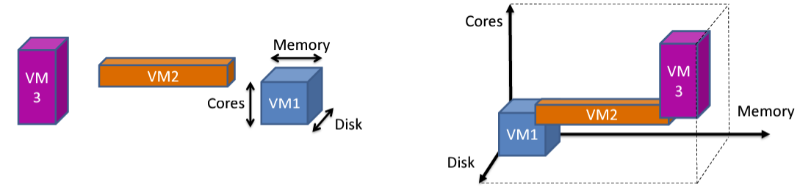
Virtual Machine (VM) Allocation
Resource constraints
Sum of recourses of all VMs on a node cannot exceed server resources (CPU, memory, disk, network, …) -> Bin-Packing
Failure domain constraints
VMs of the same tenant must be spread across many failure domains
Co-location constraints
Certain types of VMs cannot be co-located together

Slide 58
Azure Storage Architecture
Blob
Queue
File
SMB
Blob
Queue
File
SMB
Storage Stamp
Storage Stamp
LB
LB
Front-Ends
Front-Ends
Partition Layer
Partition Layer
Geo replication
Stream Layer (DFS)
Stream Layer (DFS)
Intra-stamp replication
Intra-stamp replication

Slide 59
Datacenter Innovations
1% saving or improvement means a lot at cloud scale
0.01% downtime also means a lot for a cloud

Slide 60
Azure SmartNIC: accelerate VM switch
Northbound API
Controller
Controller
Controller
Southbound API
SLB Decap
SLB NAT
VNET
ACL
Metering
Rule | Action
* | Decap
Rule | Action
* | DNAT
Rule | Action
* | Rewrite
Rule | Action
* | Allow
Rule | Action
* | Meter
Decap
DNAT
Encap
Allow
Meter
VM
VFP
REWRITE
Transposition
Engine
Flow | Action
1.2.3.1->1.3.4.1, 62362->80 | Decap, DNAT, Rewrite, Meter
GFT Offload Engine
First Packet
GFT Offload API (NDIS)
VMSwitch
GFT
Crypto
RDMA
GFT
Table
SmartNIC
100G
QoS
Flow | Action
1.2.3.1->1.3.4.1, 62362->80 | Decap, DNAT, Rewrite, Meter

Slide 61
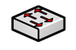
Remote Direct Memory Access (RDMA)
Memory
Allocate
Buffer A
DMA
Application
Write local buffer at address A to remote buffer at address B
Requester
Responder
Buffer B is filled
Application
Memory
Buffer B
DMA
Allocate
RDMA bypasses host OS stack
→ frees host CPU, lowers latency
Notes:
Let’s start with basic concept of RDMA. I think many of you know DMA, direct memory access. This is a feature that allows certain hardware subsystems to access main memory independently of CPU. RDMA is essentially remote DMA that crosses different machines.
In this example, there are two hosts which are connected by the network. The requester application tells its NIC ‘hey, can you send data I store in local buffer A to a remote buffer B’.
[click]
The requester’s NIC fetches data from host memory using DMA without involvement of CPU, assemble data into packets, and [click] send packets to the destination NIC through the network.
[click]
Then destination NIC de-assemble packets to get data, writes data to the memory B, and tells the responder application “Hey, someone writes something to your buffer B”
[click]
This data exchange process does not involve network stack running in OS kernel, thus freeing CPU cores. Compared to OS network stack, NIC hardware can provide much lower processing latency and better throughput.

Slide 62
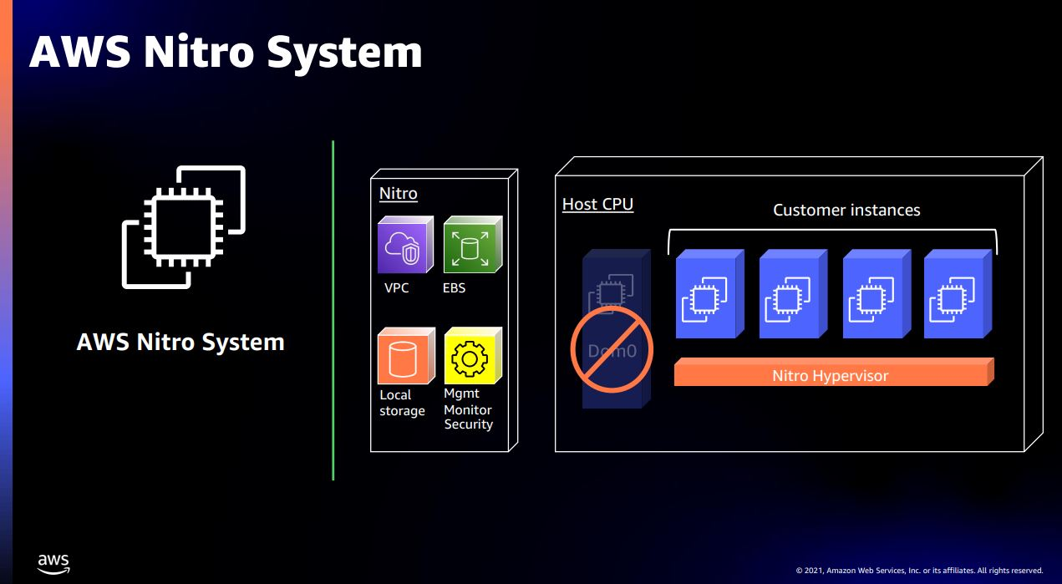

Slide 63
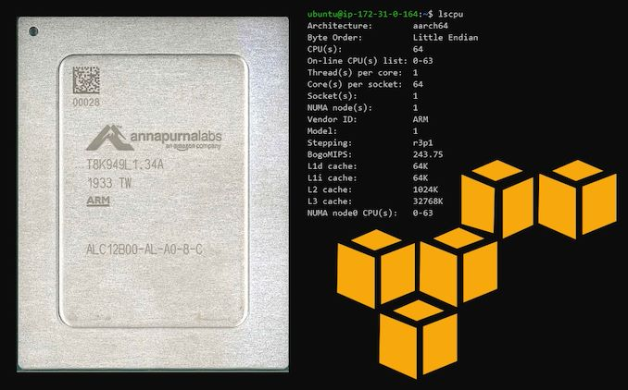
New CPUs
AWS Arm-based Graviton2 CPU

Slide 64
Next Generation Datacenter Architectures
Next Generation Network Interconnect
Compute Pool
Accelerator Pool
DRAM Pool
SSD Pool

Slide 65
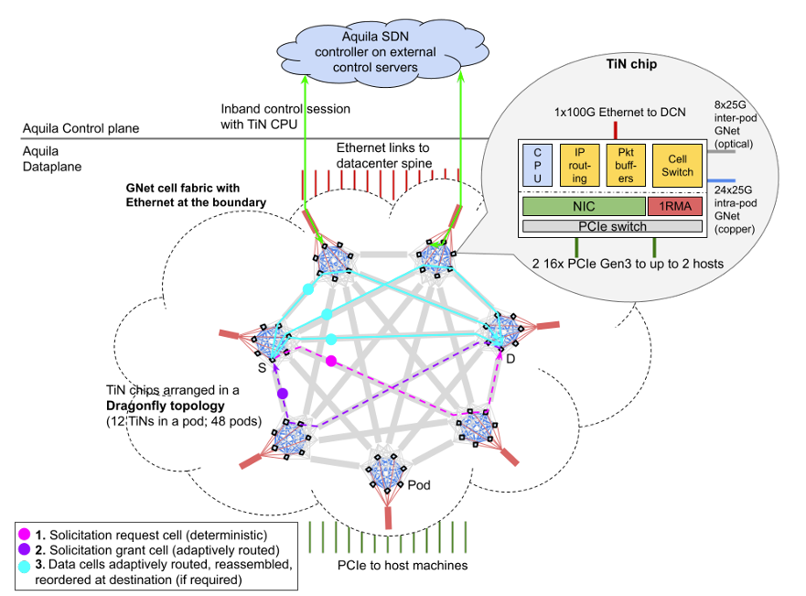
Aquila: A Unified, Low-latency Datacenter Network

Slide 66
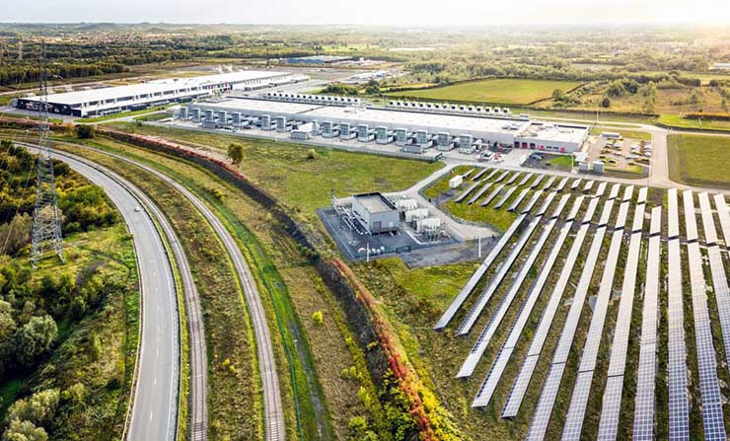
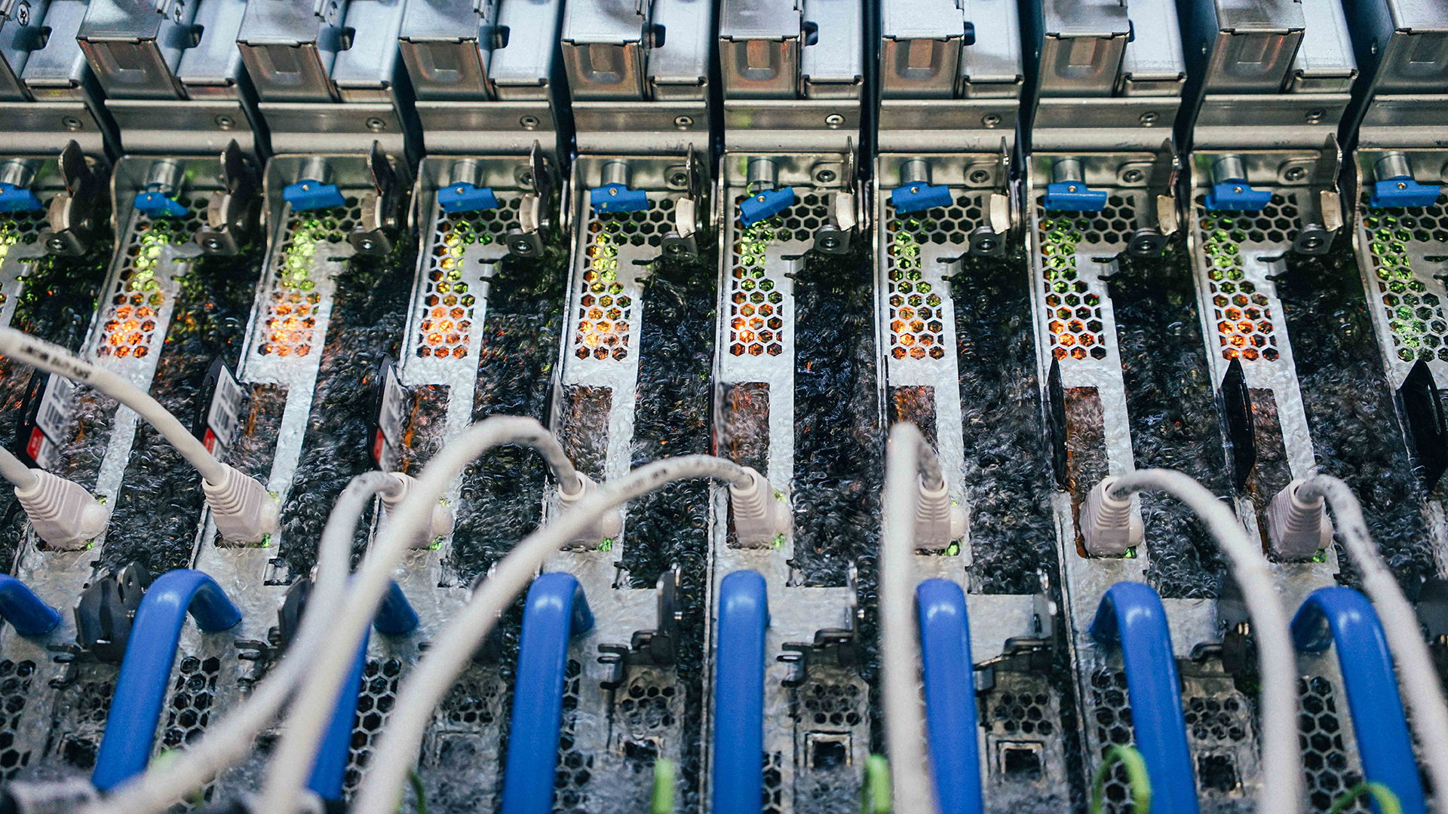
Sustainable Datacenters
An on-site solar energy array at the Google data center campus in Belgium
Boiling liquid carries away heat generated by computer servers at a Microsoft datacenter

Slide 67
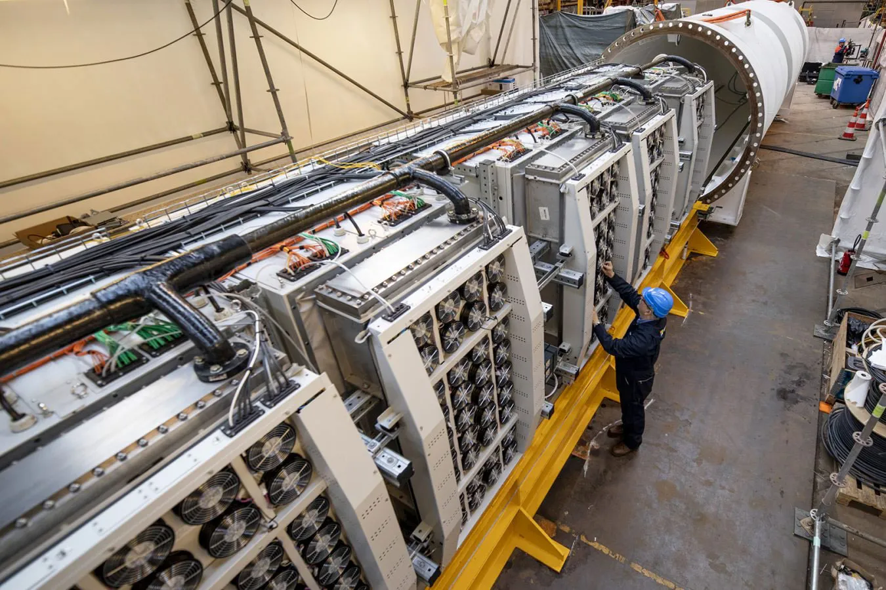
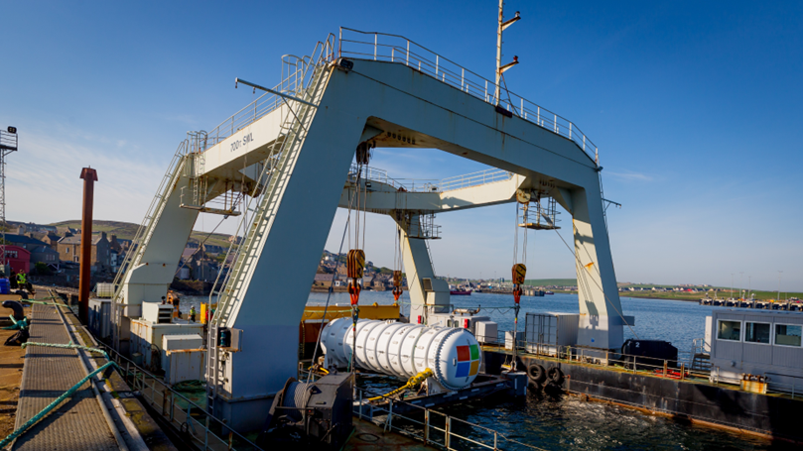
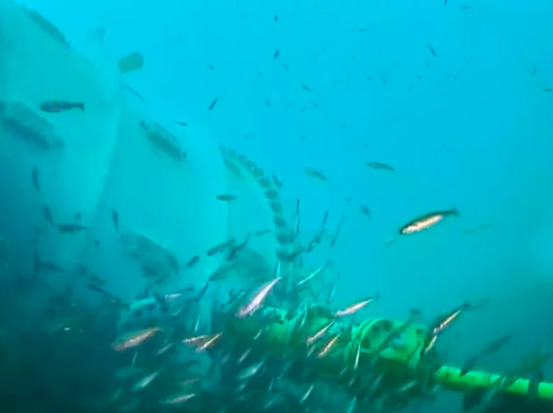
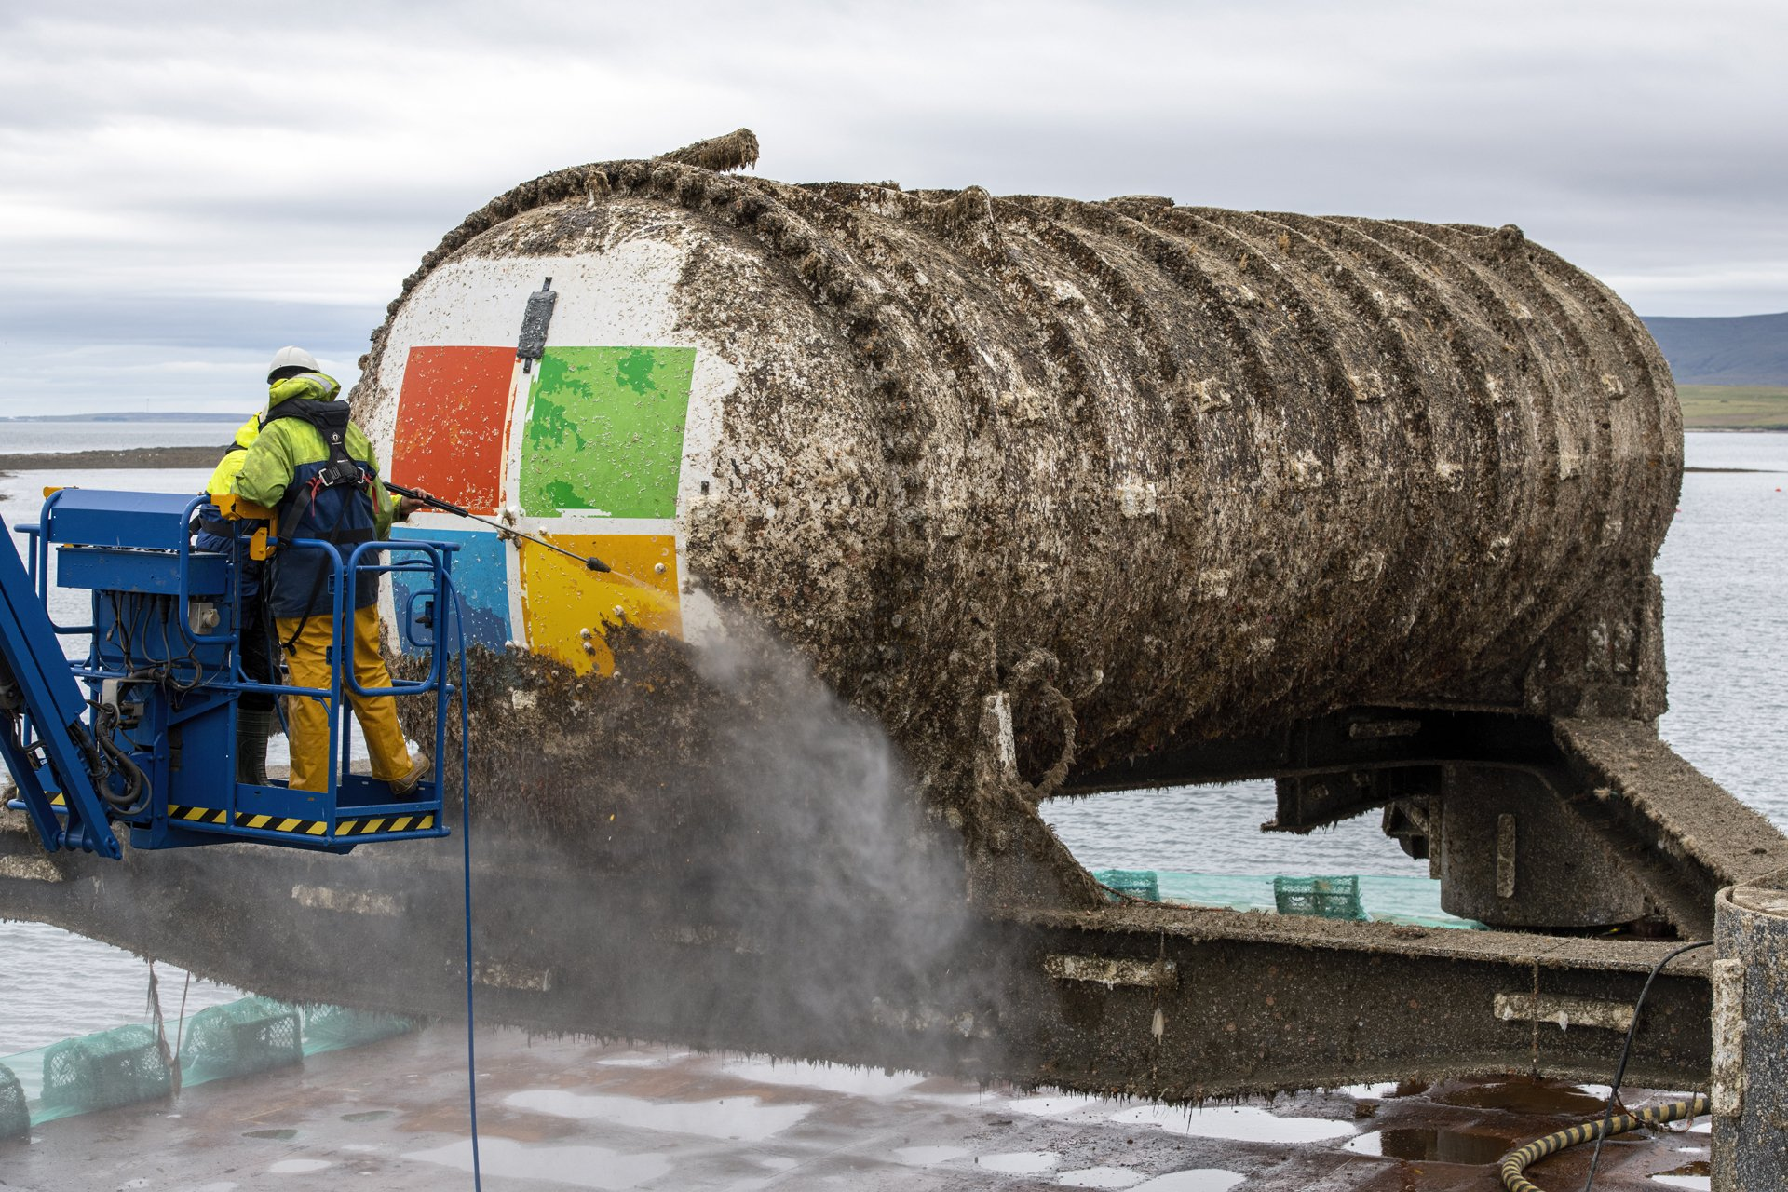
Project Natick: Underwater Datacenters
Notes:
864 servers

Slide 68
Customer Benefits
Reduce the cost of cooling by leveraging the natural sea temperature.
Benefit from offshore renewable energy sources (e.g., wave and tidal power) that could be truly zero emission.
Made from fully recyclable materials.
Reduce the latency by locating datacenters closer to customers.

Slide 69
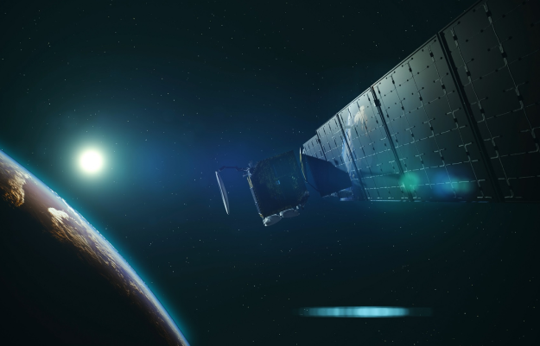

Datacenters in Space

Slide 70
Thank You!
Interested in doing an internship at Microsoft Research or Azure?
Please drop me an email webai@microsoft.com

Slide 71
Network Virtualization
Microsoft Azure Virtual Networks
Azure is the hub of your enterprise, reach to branch offices via Virtual Private Network (VPN)
VNet is the right abstraction, the counterpart of the VM for compute
Efficient and scalable communication within and across VNets
Microsoft Azure
10.1/16
10.1/16
Internet
ISP/MPLS QoS
Secure Tunnel
L3 Tunnel
Green
Red
Notes:
Patter->virtualization the billion dollar idea
Thought it would be branch. Turned out to be hub
VDC, w Vnets, and land your service in them

